Slide 1
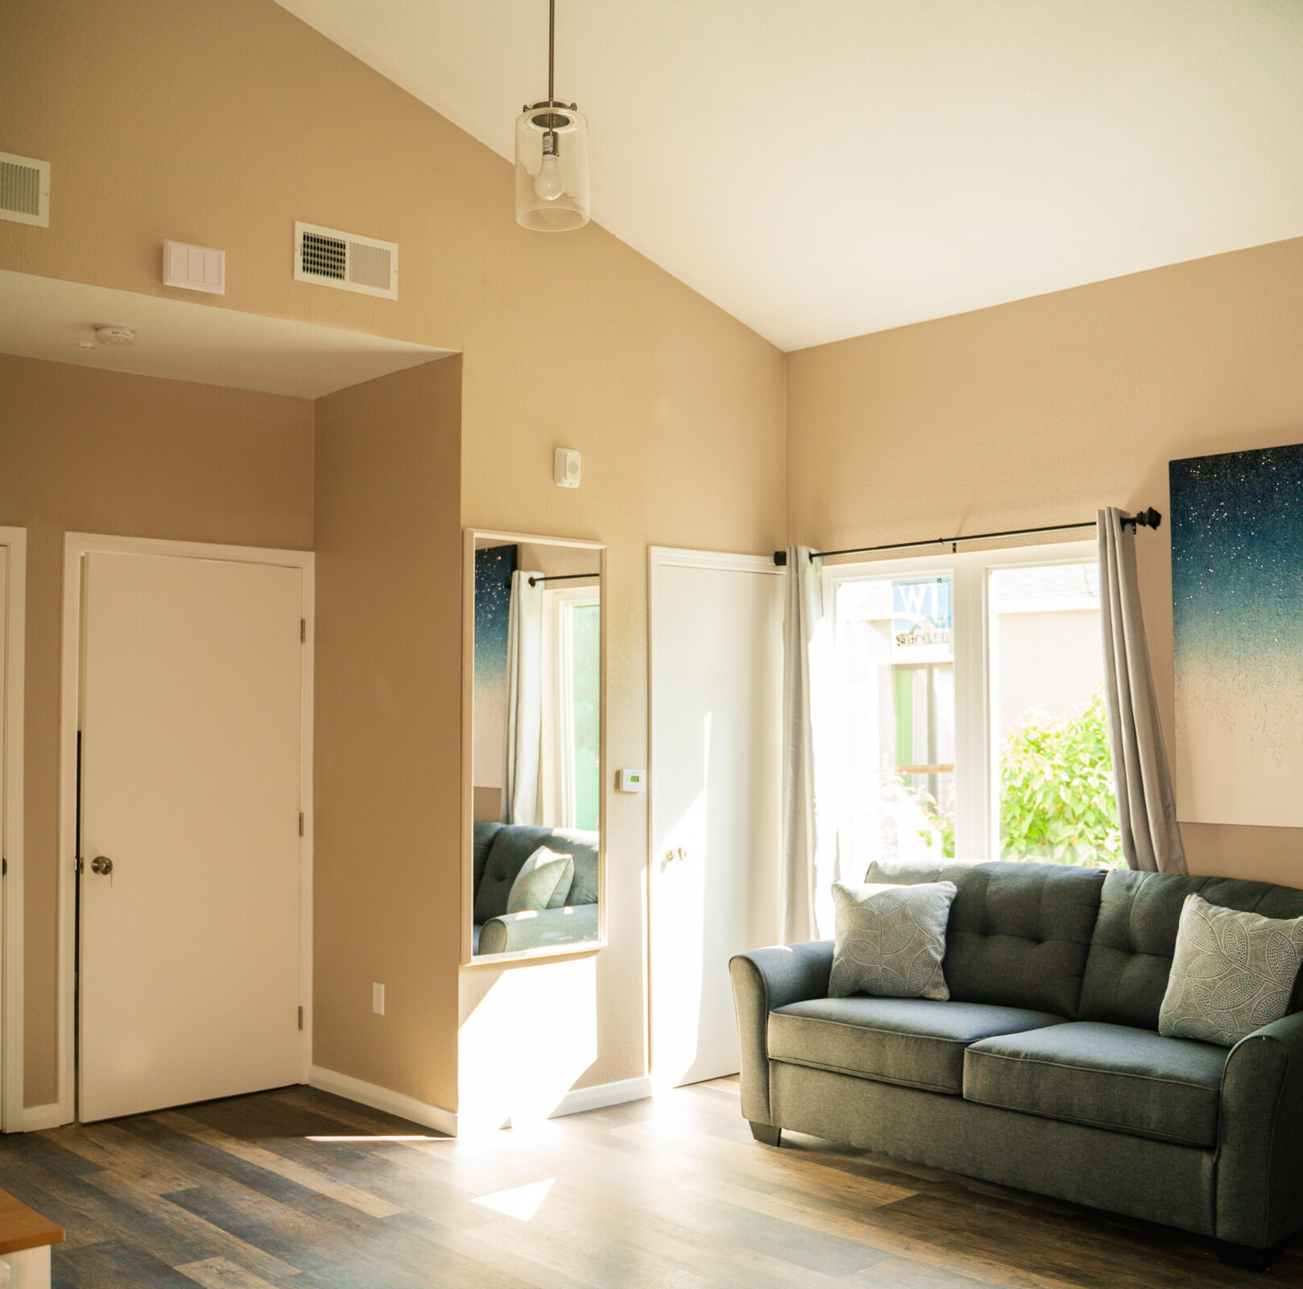
GENESIS WORSHIP CENTER
COMMUNITY DEVELOPMENT
2026
Fresh Start Academy
& New Beginnings
Year-to-Date Program Report
January 1 through September 30
Self-sufficiency • Employment
Permanent housing
WEBSITE VERSION
44 CLIENTS SERVED

Slide 2
PROGRAM OUTCOMES
Public Safety and Progress Toward Independence
44 clients served | January 1 through September 30, 2026 reporting period
44
26
32
9
Clients served
Self-sufficiency
milestones achieved
Paid work
documented
Permanently housed
at program exit
38 FSA • 6 New Beginnings
At least one achieved milestone per client
Includes 16 clients reporting new work
8 FSA • 1 New Beginnings
Housing and reentry support translated into documented progress: earned income, practical milestones and permanent homes.
At least 354 documented one-on-one sessions | 824 weekly note entries
The following slides show who we serve, then connect these results to independence, public safety and the support delivered.
Fresh Start Academy & New Beginnings | YTD 2026 | Website version
02

Slide 3
OUR PURPOSE | SUCCESSFUL REENTRY
Our Mission
Genesis Worship Center | Fresh Start Academy & New Beginnings
Our mission is to provide housing and wraparound support that help formerly incarcerated individuals achieve self-sufficiency, employment and permanent housing.
We work to reduce recidivism and build safer communities.
Fresh Start Academy & New Beginnings | YTD 2026 | Website version
03

Slide 4
OUR VISION | COMMUNITY PARTNERSHIP
Our Vision
From reentry to stability, contribution and community leadership
To restore lives and rebuild futures by providing men and women returning home with safe housing, meaningful employment, and the life skills to become fully self‑sufficient.
From reentry to stability.
From stability to contribution.
From contribution to leadership.
Alameda County Probation
UCC lending partners
Trusted partner in reentry
Church Building & Loan Fund and Cornerstone Fund
Alameda County
City of Oakland
Community investment
Local partnership and advocacy
Source:
UCC financing history
Fresh Start Academy & New Beginnings | YTD 2026 | Website version
04

Slide 5
GENESIS WORSHIP CENTER | OUR STANDARD OF SERVICE
The CREATE Philosophy | Our Standard of Service
Genesis Worship Center | Fresh Start Academy & New Beginnings Housing Programs
C
Compassion
We meet every person with dignity and empathy.
R
Responsiveness
We reply promptly and follow through.
E
Education
We equip residents, Probation, staff, community partners, and ourselves with the information and guidance needed to make informed decisions, and we commit to continual learning.
A
Accountability
We own our commitments, our outcomes, and our mistakes.
T
Transformation
We support meaningful, lasting change in the people and communities we serve.
E
Excellence
We hold every detail of our work to the highest standard.
Our CREATE Philosophy guides how we show up for one another, our residents, and our partners every day.
Fresh Start Academy & New Beginnings | YTD 2026 | Website version
05

Slide 6
GENESIS WORSHIP CENTER | PUTTING CREATE INTO PRACTICE
CREATE in Everyday Practice
Genesis Worship Center | Fresh Start Academy & New Beginnings Housing Programs
At Genesis Worship Center, our Fresh Start Academy and New Beginnings Housing programs operate under the CREATE Philosophy. It is:
Reviewed at the start of every staff meeting
Referenced in our decision-making
Reflected in how we serve residents, partner with Probation, and engage the broader community
Not a slogan, but the standard we hold ourselves to in every interaction, every document, and every outcome
Expected to be memorized by every employee and applied to every interaction with our residents, community partners, and Probation
Fresh Start Academy & New Beginnings | YTD 2026 | Website version
06

Slide 7
OUR HOUSING HISTORY | PROGRAM MILESTONES
From Vision to Housing
Genesis Worship Center | Fresh Start Academy & New Beginnings
2017
Apartment predevelopment begins
Genesis began the predevelopment phase to convert church space into apartments.
2019–2020
Joint private financing
UCC Church Building & Loan Fund and UCC Cornerstone Fund jointly financed the conversion of church space into 12 apartment units.
2021
Fresh Start Academy launches
Fresh Start Academy launched, bringing former Chief Probation Officer Wendy Still’s vision for reentry housing to life.
2023
New Beginnings expands housing access
GWC purchased 2705 Ritchie Street and launched New Beginnings to provide needed housing for people with a Penal Code section 290 registration requirement.
Source:
UCC financing history
2019: UCC loan approval. 2020 financing milestone: Genesis leadership. Other milestones: Genesis program history.
Fresh Start Academy & New Beginnings | YTD 2026 | Website version
07

Slide 8
OUR HISTORY | FIVE YEARS OF SERVICE
Celebrating Five Years
April 24, 2021 through April 24, 2026
5
Genesis Worship Center celebrated five years since the launch of its apartments and reentry housing program on April 24, 2026.
Genesis thanks the City of Oakland, Supervisor Nate Miley, the Alameda County Board of Supervisors, Alameda County Probation Department, New Way Homes, UCC Church Building & Loan Fund, UCC Cornerstone Fund and Envision Housing for their key roles in making this housing possible.
YEARS OF SERVICE
2021–2026
Source:
New Way Homes
UCC financing history
Fresh Start Academy & New Beginnings | YTD 2026 | Website version
08

Slide 9
PROGRAM REACH | PRIOR RESIDENCE SURVEY
Where Participants Came From: Prior Residence Survey
Client-reported prior residence and Supervisorial District, from all 33 survey forms
Why this information matters
Survey evidence
Shows the program’s geographic reach across Alameda County’s five Supervisorial Districts and beyond.
Shows the living situations clients were leaving, including the street, jail, shelter, and family settings.
Gives the community direct, client-reported information on who the program serves.
Complements the program’s referral-event records.
33 Prior Residence and Supervisorial District forms were completed September 21–24, 2026. Each form was counted once.
The next slide shows where clients lived by District. The slide after it shows the type of residence they came from.
79% last lived in Alameda County; 58% came from the street, jail, or a shelter.
Source: Prior-residence surveys, September 2026. Client-reported responses; no client names or identifying information are shown.
Fresh Start Academy & New Beginnings | YTD 2026 | Website version
09

Slide 10
PROGRAM REACH | PRIOR RESIDENCE SURVEY
Total forms: 33
Where Clients Lived Before Entering the Program
Prior residence by Alameda County Supervisorial District, as listed on the survey form
WHAT THIS SHOWS
District 1
East County / Tri-Valley Area
0
District 2
South County Area
7
District 3
Central / East Bay Area
6
79%
0.0% of clients
21.2% of clients
18.2% of clients
of clients (26 of 33) last lived in Alameda County
Dublin, Livermore, Sunol, Castlewood, Happy Valley, Livermore-Amador Valley, or part of Fremont or Pleasanton
Hayward, Newark, Union City, or part of Fremont
Alameda, San Leandro, San Lorenzo, Hayward Acres, or Oakland areas such as Chinatown, Jack London Square, San Antonio, Fruitvale, or Melrose
None reported
Street 2 · Family 2 · Shelter 1 · Other program 1 · Other 1
Jail 2 · Street 1 · Shelter 1 · Family 1 · Other 1
Clients came from across the County. Districts 2 and 5 were highest with 7 each; Districts 3 and 4 had 6 each.
No client reported District 1 (East County / Tri-Valley).
5 clients (15%) came from outside the County: Santa Cruz (2), Sacramento, San Francisco and Sonoma.
2 clients (6%) did not report a district.
District 4
Central County / East Oakland Area
6
District 5
North County / North Oakland Area
7
Outside Alameda County
Santa Cruz (2), Sacramento, San Francisco, Sonoma
5
18.2% of clients
21.2% of clients
15.2% of clients
Castro Valley, Ashland, Cherryland, Fairview, El Portal Ridge, Fairmont Terrace, Hillcrest Knolls, or part of Oakland, Pleasanton, or Sunol
Albany, Berkeley, Emeryville, Piedmont, West Oakland, North Oakland, or portions of the Oakland Hills
All outside-county clients reported California residences
Family 4 · Jail 1 · Street 1
Street 4 · Shelter 2 · Family 1
Hospital/treatment 2 · Street 2 · Jail 1
Unknown / Prefer not to answer: 2 (6.1%) 1 marked unknown, 1 left district blank
Source: BOS prior-residence survey forms, September 2026. All 33 forms counted. The bottom line of each card shows the type of residence reported by those clients.
Fresh Start Academy & New Beginnings | YTD 2026 | Website version
10

Slide 11
PROGRAM REACH | PRIOR RESIDENCE SURVEY
Total forms: 33
Where Clients Were Staying Before Program Entry
Type of residence immediately before entering the program, as listed on the survey form
WHAT THIS SHOWS
0
0.0%
Own or rented housing
No client came from housing of their own
4
12.1%
Shelter or transitional housing
58%
11
33.3%
Street, vehicle, encampment, or other place not meant for habitation
Includes 2 who also wrote “Car” under Other
4
12.1%
Jail, prison, juvenile facility, or other correctional setting
2 more checked both Street and Jail
of clients (19 of 33) came from the street, jail, or a shelter
11 came from the street or a vehicle, 4 from jail or a correctional setting, and 4 from a shelter.
8 clients (24%) were staying with family or friends. None came from their own or rented housing.
Justice involvement: 4 clients came directly from jail, and 2 more checked both Street and Jail, so up to 6 clients (18%) reported a correctional setting.
8
24.2%
Staying with family or friends
2
6.1%
Another housing or service program
2
6.1%
Hospital, treatment program, or behavioral-health facility
2
6.1%
Other / unknown
Both Street and Jail checked
Housed / with others
Shelter
Unsheltered
Institutional / program
Other
Source: BOS prior-residence survey forms, September 2026. All 33 forms counted; 2 forms checked both Street and Jail and are shown under Other / unknown.
Fresh Start Academy & New Beginnings | YTD 2026 | Website version
11

Slide 12
PROGRAM OUTCOMES
Program Capacity and Availability
Wait-list and openings as of September 30, 2026
44
0
1
Full
Clients served
year to date
On the wait-list
Opening at
New Beginnings
Fresh Start Academy
at capacity
Includes earlier-year admissions
As of September 30, 2026
As of September 30, 2026
As of September 30, 2026
Clients admitted before 2026 also contributed to this year’s program results.
Wait-list and capacity status reflect the September 30, 2026 snapshot.
Fresh Start Academy & New Beginnings | YTD 2026 | Website version
12

Slide 13
PROGRAM OUTCOMES
Program Participation and Client Status
Latest recorded status: August 31 baseline plus the confirmed September completion
Client status
Fresh Start
New Beginnings
Total
Active
19
4
23
Successfully completed
8
2
10
Participant Quit
3
0
3
Expelled
4
0
4
Aftercare
1
0
1
Program Expiration
1
0
1
Deceased
1
0
1
Other administrative closure
1
0
1
Total clients
38
6
44
2 clients re-arrested after admission | 4.55% of 44 clients served
One enrollment status per client; rearrests can overlap these statuses. Of the 10 completions, 9 exited to permanent housing. September 30 status reconciliation pending.
Fresh Start Academy & New Beginnings | YTD 2026 | Website version
13

Slide 14
PROGRAM OUTCOMES
Housing Outcomes Among Program Exits
10 clients exited; 9 secured permanent housing
Client outcomes
9
Total: 10 program exits
Permanently housed at exit
9
90.0%
Permanently housed at exit
Exited without permanent housing
1
10.0%
90.0% of 10 program exits
8 Fresh Start Academy and 1 New Beginnings client secured permanent housing
One New Beginnings client remains engaged in post-exit senior-housing navigation.
One New Beginnings client exited without permanent housing after staff assisted with applications to multiple senior-housing programs. He remains engaged in post-exit housing navigation and hopes to secure permanent senior housing by December 2026.
Fresh Start Academy & New Beginnings | YTD 2026 | Website version
14

Slide 15
PROGRAM OUTCOMES
Permanent Housing | Key Wins
YTD results | Practical progress toward independent living
8 Fresh Start Academy clients
9
Permanent housing represents a concrete transition from program housing to independent living.
1 New Beginnings client
Permanently housed at exit
One New Beginnings client secured permanent housing after program exit.
90.0% of 10 program exits
1 continuing housing case
Staff continue senior-housing applications and navigation after program exit.
Fresh Start Academy & New Beginnings | YTD 2026 | Website version
15

Slide 16
PROGRAM OUTCOMES
Building Independence
26 clients achieved practical milestones that support everyday independence
Client outcomes
26
Total: 44 client records
Completed milestone documented
26
59.1%
Clients with at least one
completed milestone
Other client records
18
40.9%
59.1% of the 44 reviewed clients
Completed steps include school enrollment, licensing, transportation, health care and financial goals: practical progress toward independent living.
Fresh Start Academy & New Beginnings | YTD 2026 | Website version
16

Slide 17
PROGRAM OUTCOMES
Self-Sufficiency | Key Wins
YTD results | Practical progress toward independent living
Practical barriers addressed
59.1%
Completed steps include transportation, licensing, health care and financial goals.
Education and skills
Achieved a completed
self-sufficiency milestone
School enrollment and training milestones support clients’ next steps toward independence.
Year-to-date progress
26 of 44 clients through September 30, 2026
Newly documented achievements include a Class A license, transportation access and health appointments.
Fresh Start Academy & New Beginnings | YTD 2026 | Website version
17

Slide 18
PROGRAM OUTCOMES
Employment and Earned Income
32 clients had paid work documented, including 16 who reported new work
Client outcomes
32
Total: 44 client records
Paid work documented
32
72.7%
Clients with paid work
documented
Other client records
12
27.3%
72.7% of the 44 reviewed clients
Clients earned income through security, construction, other jobs and self-employment while working toward greater financial independence.
Fresh Start Academy & New Beginnings | YTD 2026 | Website version
18

Slide 19
PROGRAM OUTCOMES
Employment | Key Wins
YTD results | Practical progress toward independent living
16 clients reported new work
72.7%
Documented paid work includes jobs, construction, security and self-employment.
Preparation for opportunity
Had paid work
documented
Case management supports applications, interviews, training, transportation and work-related needs.
Income and independence
32 of 44 clients
Clients are building work experience while pursuing employment and financial goals.
Fresh Start Academy & New Beginnings | YTD 2026 | Website version
19

Slide 20
PUBLIC SAFETY & REENTRY
Stable Housing. Support. Safer Communities.
42 of 44 clients had no recorded qualifying post-admission rearrest
95.45%
Housing paired with consistent support
Stable housing, weekly case management and practical assistance support clients as they rebuild their lives and work toward a crime-free future.
No recorded qualifying
post-admission rearrest
At least 354 one-on-one sessions
Daily food support for clients
824 weekly notes documenting client support
42 of 44 clients served
4.55% recorded rearrest rate
Clients credit the program with helping them avoid crime
All 22 respondents said the program made them less likely to commit crime. 21 of 22 said it helped keep them from jail or prison; one left that item blank.
September 2026 survey | Clients’ own assessment of the program’s impact
Recorded rearrest rate: 2 of 44 clients = 4.55%. Excludes pre-admission arrests and previously scheduled sentences.
Fresh Start Academy & New Beginnings | YTD 2026 | Website version
20

Slide 21
PUBLIC SAFETY | HISTORICAL COMPARISON
Recorded Rearrests | 2025 and 2026
Historical January–August 2025 compared with available 2026 YTD records
JANUARY–AUGUST 2025
2026 YTD | SEPTEMBER UPDATE
3.70%
4.55%
2 new arrests / 54 clients served
2 clients re-arrested / 44 clients served
Two recorded arrests in each reporting population; the percentages reflect different numbers served.
Additional history in the November 2025 AB 109 report
January–October 2025: 2 new arrests / 58 served = 3.45% (page 155).
2024–YTD 2025 combined: 6 returns to incarceration / 110 served = 5.5% as reported (page 105). This is not a 2025-only rate.
Reporting definitions and periods are summarized in the Reporting Notes.
Fresh Start Academy & New Beginnings | YTD 2026 | Website version
21

Slide 22
HOUSING + SERVICES | PUBLIC SAFETY
Our Results in the Context of Research
Fresh Start Academy and New Beginnings | 44 clients served
95.45%
32
9
26
No recorded qualifying
post-admission rearrest
Clients with
paid work
Permanently housed
at program exit
Clients achieving
self-sufficiency milestones
Our approach: stable housing, food, 24/7 staffing, case management, mentoring, employment assistance and permanent-housing support.
Outside research supports the housing-and-services approach
Denver randomized trial: 40% fewer arrests over three years among people offered supportive housing and intensive services.
Ohio evaluation: 27.3% rearrested with supportive housing versus 37.3% in the comparison group over one year.
Los Angeles Just in Reach: 56% had no qualifying return to jail over two years after receiving housing and intensive support.
Urban Institute · 2021
Urban Institute · 2012
HUD Cityscape · 2023
Studies examine similar approaches; populations, definitions and follow-up periods differ. Our results reflect our own program records, not a head-to-head evaluation.
42 of 44 had no recorded qualifying post-admission rearrest. Outcome categories overlap; September records available to date.
Fresh Start Academy & New Beginnings | YTD 2026 | Website version
22

Slide 23
SUPPORT PROVIDED | PROGRAM REACH
Client Support & Reach
Program reach, documented services and practical assistance
YTD outcome
Fresh Start
New Beginnings
Combined
Clients served
38
6
44
Permanent housing at exit
8
1
9
354
824
One-on-one sessions
Weekly note entries
Fresh Start Academy & New Beginnings | YTD 2026 | Website version
23

Slide 24


OUR HOUSING ENVIRONMENT
A Welcoming Place to Rebuild
Fresh Start Academy | Furnished apartment interiors
Apartment kitchenette
Kitchen and everyday living space
Stable housing provides the foundation for individualized support and progress.
Fresh Start Academy & New Beginnings | YTD 2026 | Website version
24

Slide 25
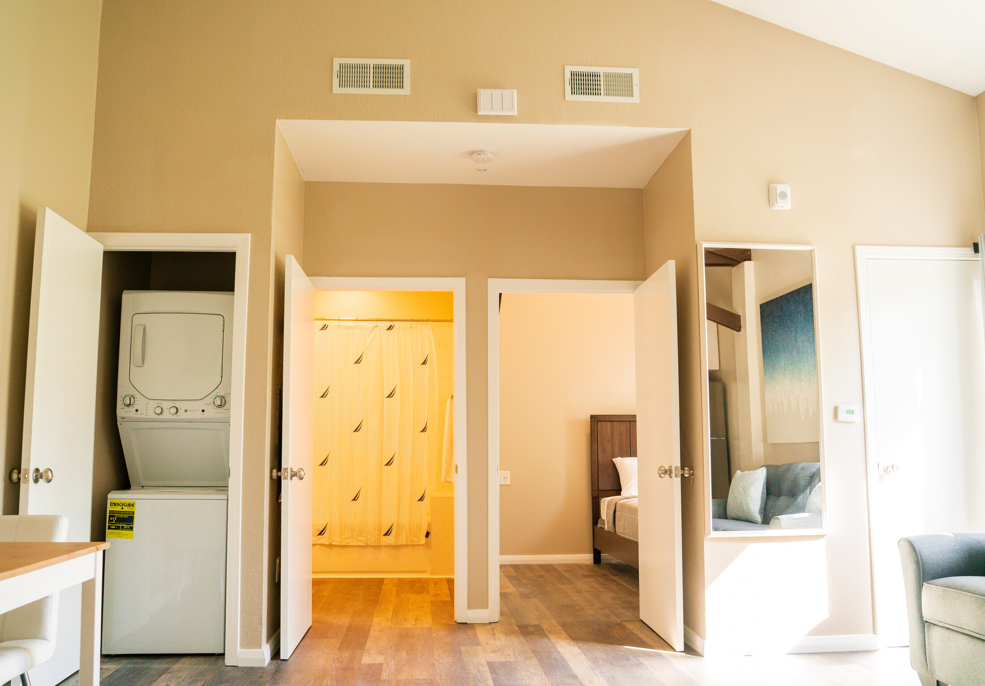

OUR HOUSING ENVIRONMENT
Supporting Everyday Independence
Fresh Start Academy | Practical amenities within the housing environment
In-unit laundry and living space
Bathroom facilities
A place to manage daily needs while working toward self-sufficiency.
Fresh Start Academy & New Beginnings | YTD 2026 | Website version
25

Slide 26
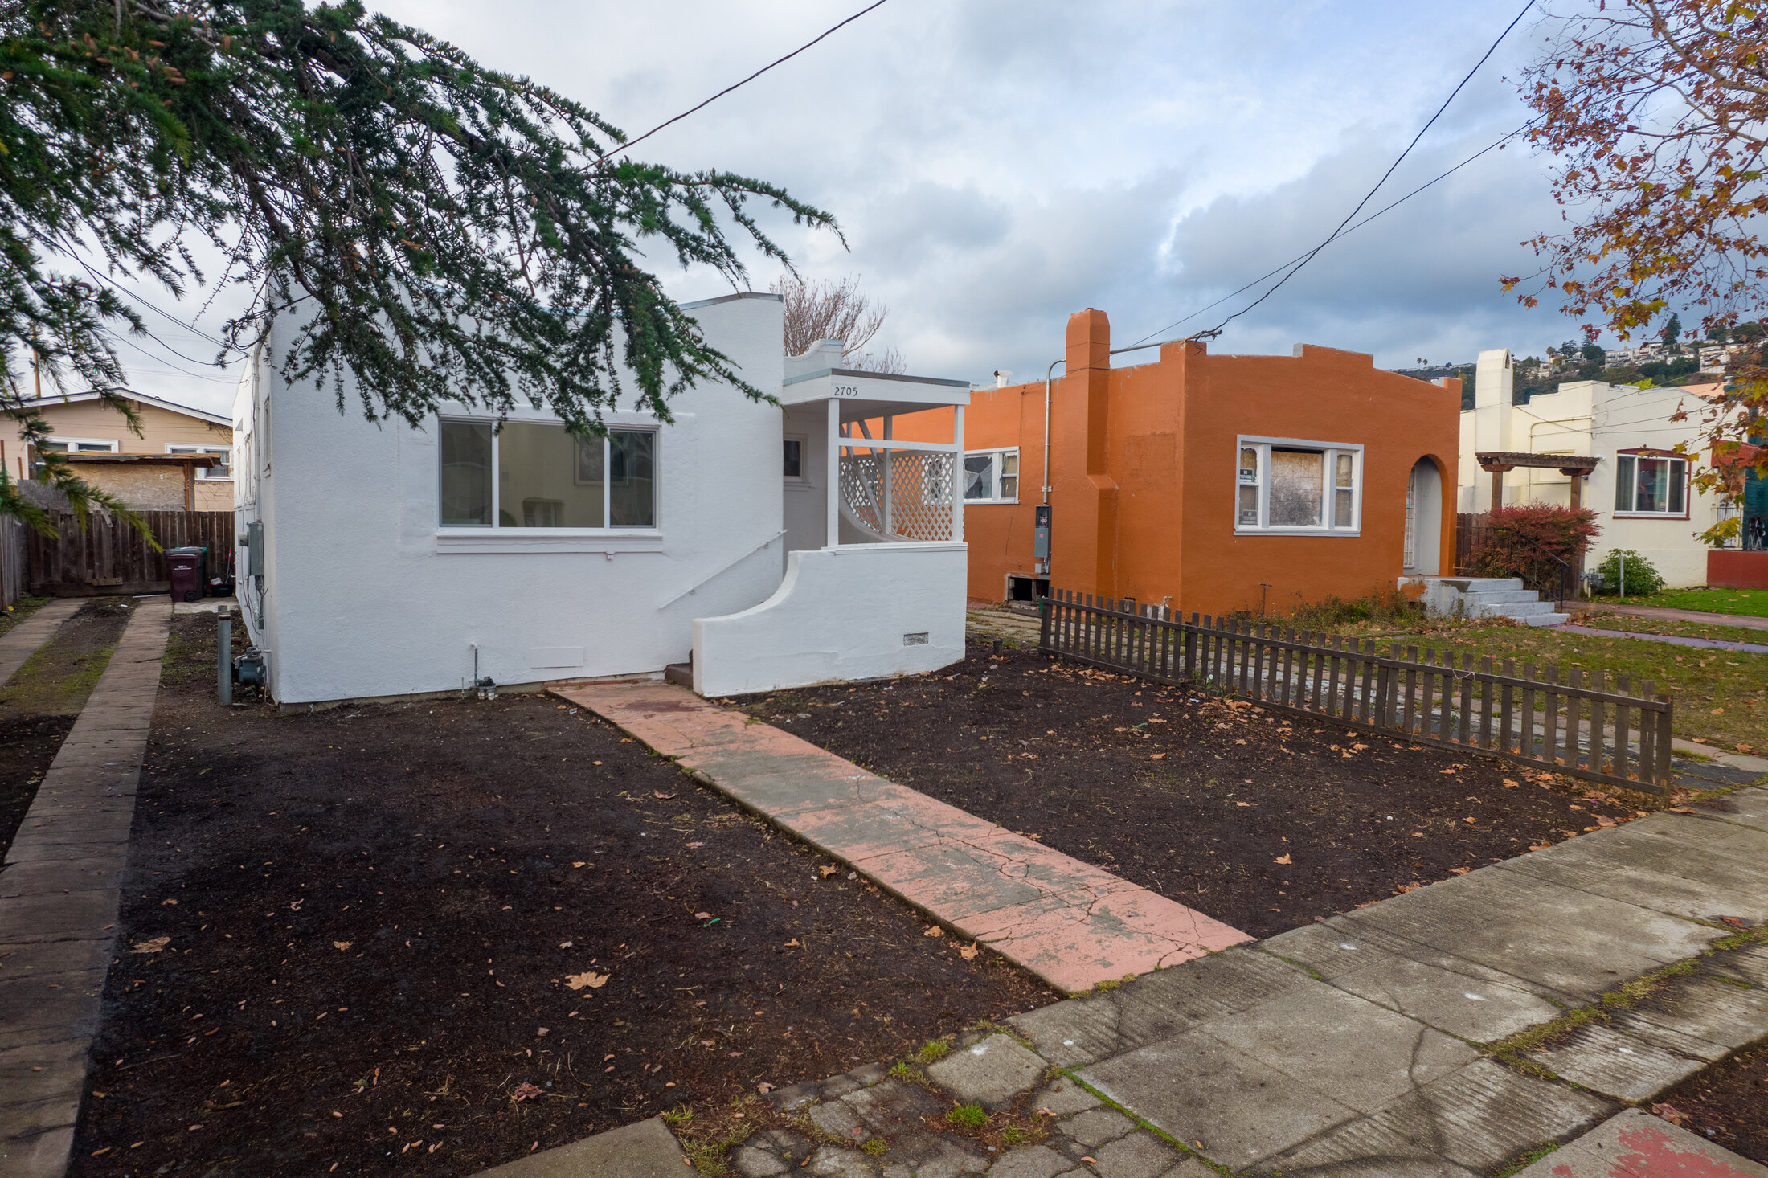

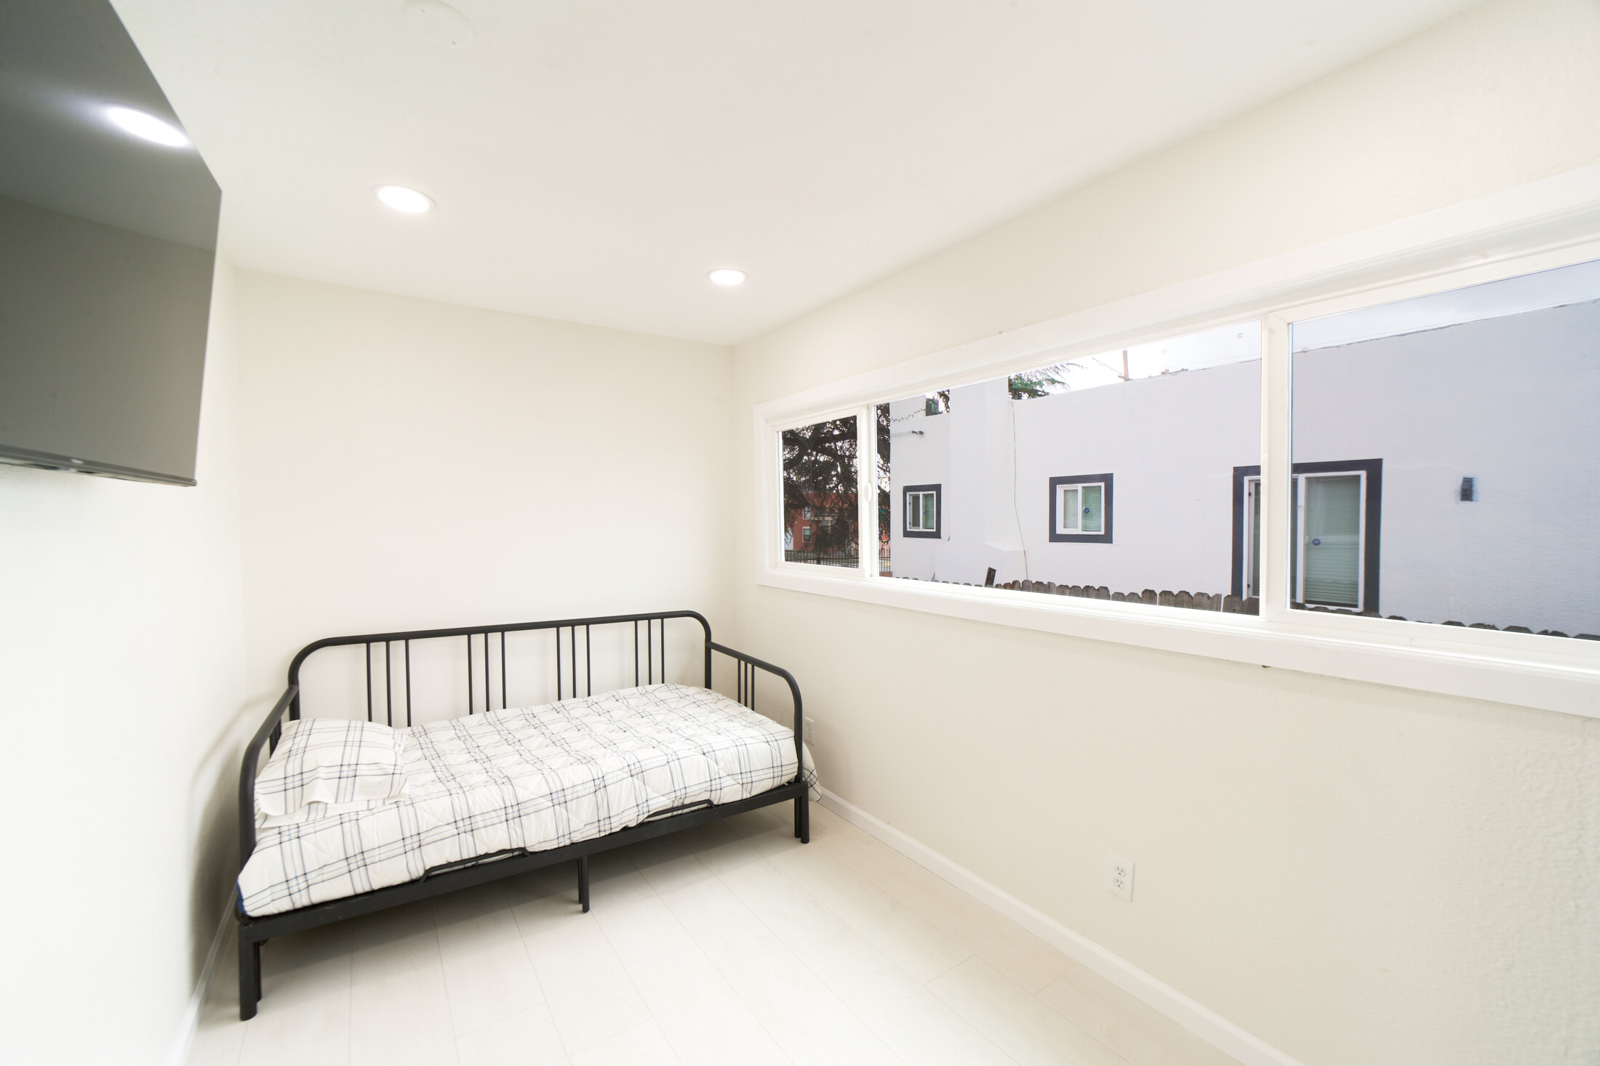
OUR HOUSING ENVIRONMENT
New Beginnings: A Place to Start Again
Program housing at 2705 Ritchie Street, Oakland
Shared living room
New Beginnings house
Furnished bedroom
Program housing supports the pathway toward employment and permanent housing.
Fresh Start Academy & New Beginnings | YTD 2026 | Website version
26

Slide 27

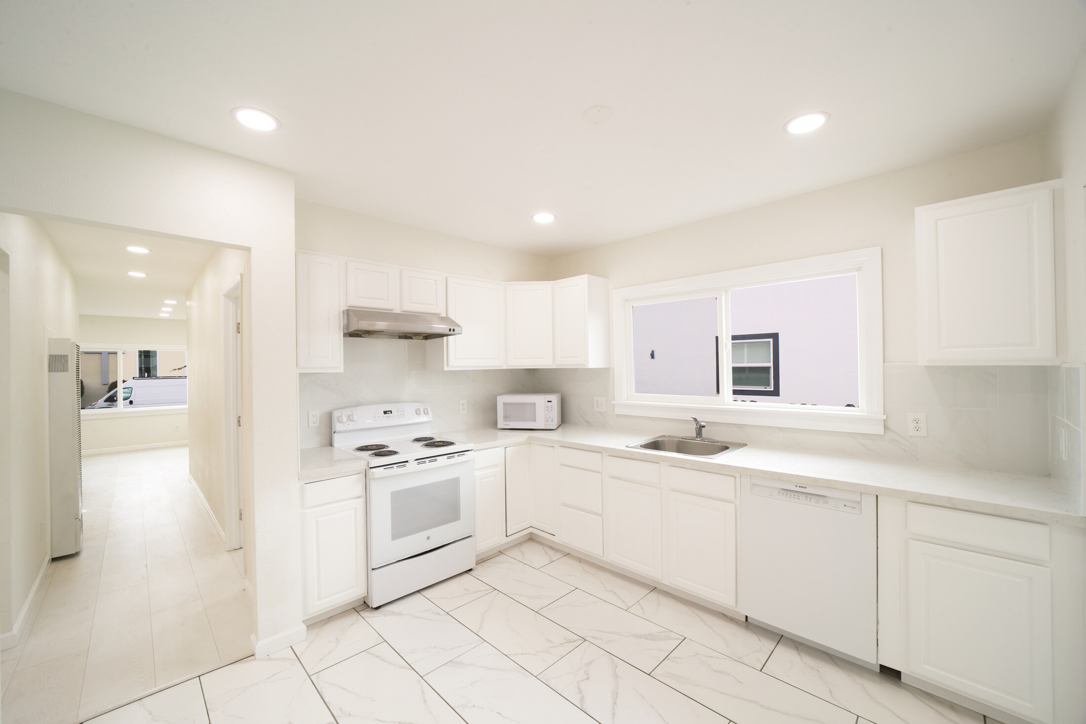
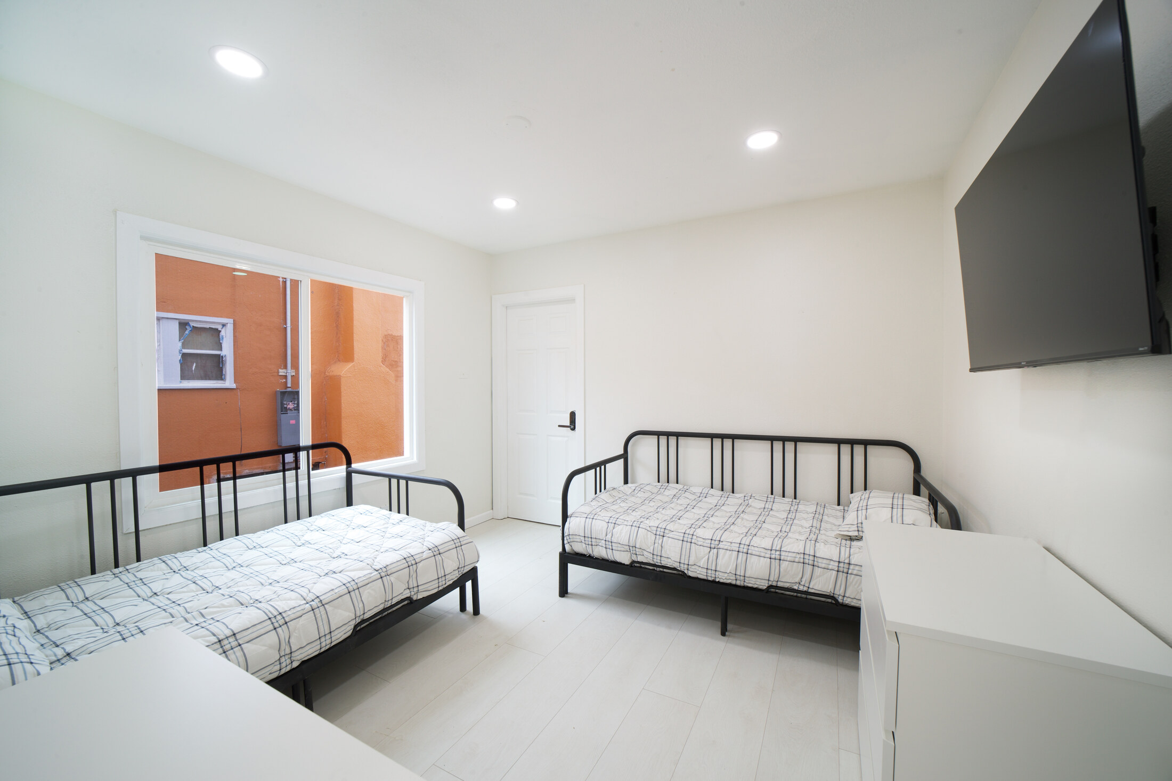
OUR HOUSING ENVIRONMENT
Inside New Beginnings
Living spaces designed for daily routines and a stable home environment
Kitchen
Shared living space
Furnished bedroom
Housing and wraparound support work together throughout the reentry journey.
Fresh Start Academy & New Beginnings | YTD 2026 | Website version
27

Slide 28
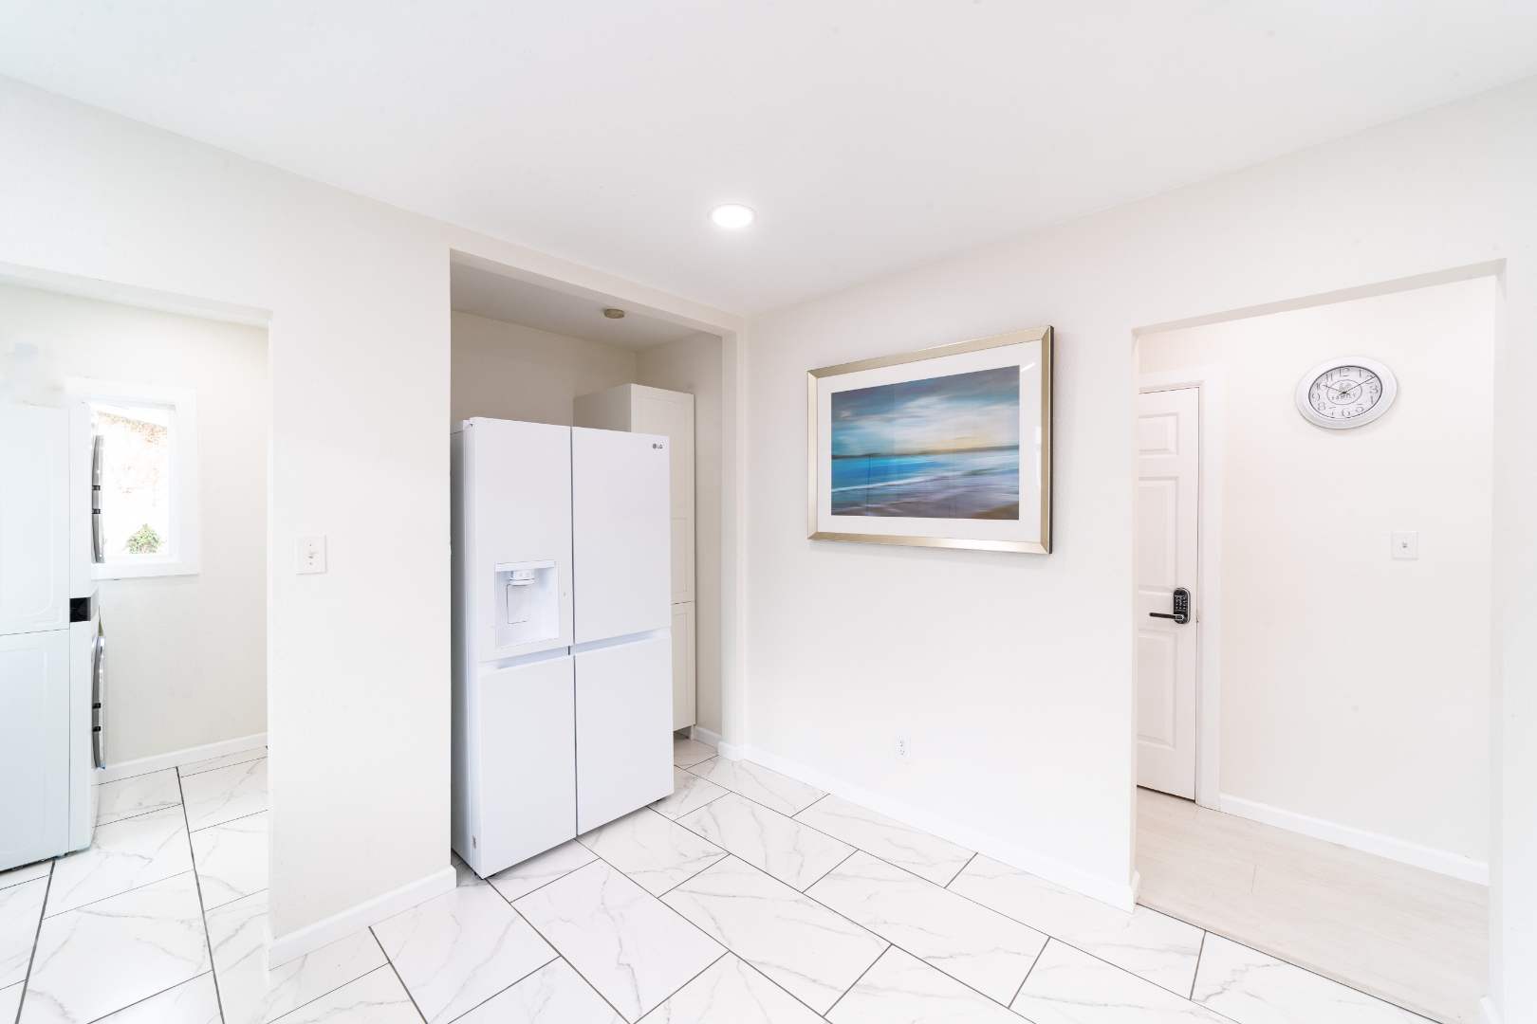




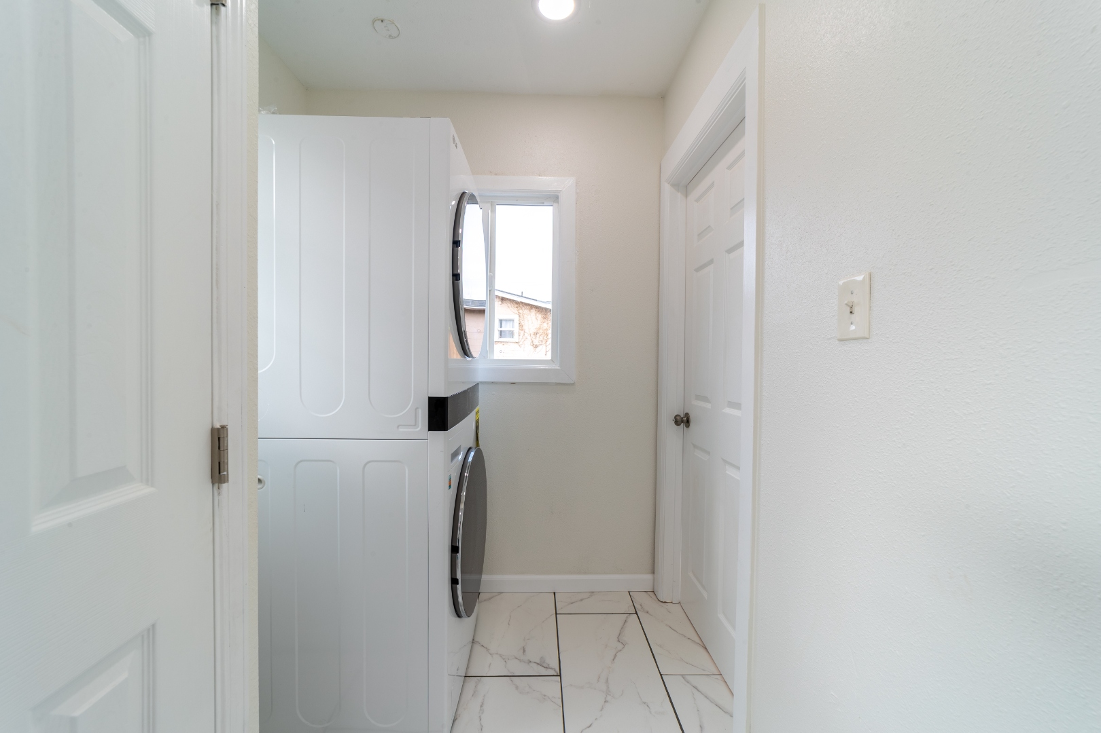
OUR HOUSING ENVIRONMENT
New Beginnings: A Safe Place to Rebuild
Program housing at 2705 Ritchie Street, Oakland
Stable, furnished living environments support daily routines, self-sufficiency, employment, and the pathway to permanent housing.
Fresh Start Academy & New Beginnings | YTD 2026 | Website version
28

Slide 29
CLIENT JOURNEY | INDIVIDUALIZED SUPPORT
From Intake to Permanent Housing
Every client’s pathway begins with intake and an individualized evaluation.
1
2
3
4
5
6
Intake
Evaluation
Case Management
Self-Sufficiency
Employment
Housing
Welcome the client and identify immediate needs.
Assess strengths, goals already met and barriers.
Build a Client Care Plan and individualized SMART goals.
Address ID, documents, transport, phone and essential needs.
Job readiness and employment; CORE and partner referrals.
Budget, save, search, apply and prepare to move.
EXIT GOAL: Clients secure permanent housing before leaving the program.
Weekly case management continues throughout: review goals, address barriers and track progress in Salesforce.
Source: Genesis program leadership and documented client needs. Each Care Plan reflects the client’s starting point and progress.
Fresh Start Academy & New Beginnings | YTD 2026 | Website version
29

Slide 30
CASE MANAGEMENT | GOALS, WEEKLY SUPPORT AND OUTCOMES
SMART Goals Guide Weekly Client Progress
Multiple individualized goals across Self-Sufficiency, Employment and Housing
S
Specific
M
Measurable
A
Achievable
R
Relevant
T
Time-bound
A clear action or outcome
A way to track progress
Realistic with the right support
Aligned with the client’s needs
A target completion date
Self-Sufficiency
Employment
Housing
Mental-health, substance-use, medical, dental and record-expungement referrals.
Job-readiness and employment support; referrals to CORE and other partner agencies.
Goals support housing readiness and the transition to permanent housing.
Goals established with clients and reviewed every week
We establish multiple individualized goals in self-sufficiency, employment and housing. Case managers review progress with clients weekly, update goals as needs change and track Care Plans and outcomes in Salesforce.
This structured, weekly approach supports the client progress and outcomes documented in this report.
Source: Genesis Worship Center leadership; client care-planning and weekly case-management practices.
Fresh Start Academy & New Beginnings | YTD 2026 | Website version
30

Slide 31
SYSTEM DESIGN | CLIENT-CENTERED REENTRY
Designed for Reentry, Built Around Client Care
A custom Salesforce system developed by Bishop George Matthews for Genesis Worship Center
18 months of development and fine-tuning
Built-in Client Care Plans
Case managers maintain each client’s care plan directly in Salesforce.
Bishop Matthews drew on his employment experience at Hewlett-Packard, Salesforce and Kaiser Permanente, together with his work as a hospice pastor, to develop a structured approach to reentry case management.
Built-in SMART goals
Specific, Measurable, Achievable, Relevant and Time-bound.
Adapting care-planning practices to reentry
Client weekly notes
Case managers document weekly progress, services and follow-up in Salesforce.
His experience with Kaiser’s Epic-based approach to care plans, documentation and reporting informed the design. Genesis applies those care-planning principles through custom Salesforce tools for client services, progress tracking and program reporting.
Client outcomes and reporting
Track client data and outcomes, measure progress and prepare program reports.
SMART goals turn client priorities into clear actions, measurable progress and target completion dates.
Source: Bishop George Matthews, developer. Custom Genesis tools built on Salesforce; care-planning inspiration does not imply Kaiser or Epic affiliation or endorsement.
Fresh Start Academy & New Beginnings | YTD 2026 | Website version
31

Slide 32
CASE MANAGEMENT | CONNECTED STAFF AND SERVICES
One System for Coordinated Client Care
Salesforce connects staff communication, client records, meetings and reporting
Built into Salesforce
Additional ways it can support care
Salesforce Chatter
Continuity of care
Case managers communicate with staff and coordinate client follow-up.
Shared client history supports smoother staff handoffs.
Clearer accountability
Centralized file management
Care Plans and SMART goals clarify follow-up priorities.
Client documents, weekly notes, Care Plans and SMART goals in one system.
Earlier identification of needs
Reviewing progress helps surface unresolved barriers.
Client–case manager meetings
Less fragmented documentation
Document meetings, progress, next steps and follow-up needs.
Central records reduce reliance on separate paper files.
Easier County reporting
Data tracking and reporting
Organized records make supporting details easier to retrieve.
Track services, client outcomes and progress toward goals.
Continuous program improvement
Outcome patterns help identify where support is needed.
Genesis reports increased productivity, stronger staff communication and a greater ability to serve clients.
Source: Genesis program leadership; qualitative assessment of operational improvements.
Fresh Start Academy & New Beginnings | YTD 2026 | Website version
32

Slide 33
CLIENT EXPERIENCE | CLIENT VOICE
Client Voices: What Participants Told Us
September 2026 client survey (22 respondents)
22
100%
95.5%
100%
Survey respondents
Less likely to commit crime
Helped keep me from jail or prison
Hopeful for a better future
September 2026 client survey
22 of 22 respondents
21 of 22 respondents
22 of 22 respondents
About the survey
In clients’ own words
Results follow by topic: AB 109 outcomes, support and personal growth, housing and program quality, and hope and gratitude.
Percentages show Yes + Sometimes responses out of 22 forms. Housing and program-quality items are average ratings on a five-point scale.
Respondents describe the program as helping them make better choices, feel safe, reduce stress, and remain hopeful.
Written comments describe the program as a source of safety, stability and hope.
Source: September 2026 client survey. Additional client survey responses are being coded and will be added in future reporting.
Fresh Start Academy & New Beginnings | YTD 2026 | Website version
33

Slide 34
CLIENT EXPERIENCE | SURVEY FINDINGS
September 2026 Client Survey
22 respondents describe the program’s contribution to safety, stability and successful reentry
SECTION 1 | AB 109 OUTCOMES
SECTION 3 | HOUSING AND PROGRAM QUALITY
Helped keep me from jail or prison
95.5%
My housing needs are being met
4.7/5
Less likely to commit crime
100%
Housing is clean and well kept
4.8/5
No need to commit crime to survive
90.9%
Staying away from drugs and alcohol
100%
Food is good and helpful
5.0/5
Getting along better with family
100%
I feel safe in the program
4.9/5
Believe my future will be better
100%
SECTION 4 | HOPE AND GRATITUDE
SECTION 2 | SUPPORT AND PERSONAL GROWTH
Hopeful for a better future
100%
Helps me make better choices
100%
Stress and worries are less heavy
100%
Grateful for Alameda County
100%
Case managers guide me positively
100%
Can talk openly with staff
100%
Survey results shown for all 22 respondents.
People here care about me
100%
Percentages show Yes + Sometimes responses out of 22 survey forms. Housing and program-quality scores are average ratings on a five-point scale.
Source: September 2026 client survey. Response-count definitions appear in the Reporting Notes.
Fresh Start Academy & New Beginnings | YTD 2026 | Website version
34

Slide 35
PROGRAM OVERVIEW
Reporting Notes | How We Measure Results
Sources: Salesforce client records, case notes, enrollment histories and surveys
Period and coverage
January 1–September 30, 2026 reporting period. Includes available September weeks 1–3; remaining September records will be added at month-end.
Client outcomes
Counts are unique clients within each category and may overlap. Self-sufficiency means one achieved milestone; employment means paid work during YTD; permanently housed means exited to permanent housing.
Service counts
354 distinct documented one-on-one sessions and 824 weekly note entries. Repeated mentions of the same meeting count once; survey forms alone are not sessions.
Public-safety measures
2 clients with qualifying rearrests ÷ 44 clients served × 100 = 4.55%. Pre-admission arrests and scheduled sentences are excluded. Historical and outside figures retain their own definitions and periods.
Survey measures
Positive = Yes + Sometimes / 22 forms. Blank or unclear answers are excluded from positive counts. Rating means use valid responses: 21 for housing needs; 22 for other items.
Fresh Start Academy & New Beginnings | YTD 2026 | Website version
35

Slide 36
NEXT STEPS | SERVICE QUALITY AND HOUSING
Areas of Focus | Next Quarter
Q4 2026 | Building on YTD progress
1
Strengthen Case Manager Roles
Clarify responsibilities, expectations and accountability for consistent client support.
2
Weekly Training & Supervision
Provide hands-on training and supervision to strengthen service quality and follow-through.
3
Deeper Client Needs Assessment
Assess needs at intake and throughout the program to connect clients with the right support.
4
Expand County Partnerships
Strengthen connections with housing, employment, legal and record-expungement resources.
5
Sustain and Grow Our Capacity
Build the partnerships and support needed to keep serving more people returning home.
6
Build Lasting Program Support
Build lasting support so Fresh Start Academy and New Beginnings can continue serving the community.
Fresh Start Academy & New Beginnings | YTD 2026 | Website version
36

Slide 37
YEAR-TO-DATE RESULTS
What These Results Mean for Our Community
Fresh Start Academy & New Beginnings
Stable housing.
Practical support.
Measurable results.
95.45%
No recorded qualifying
post-admission rearrest
32
Clients with paid work:
earned income
Continued support helps clients build independence and contributes to community safety.
9
Permanently housed
at program exit
Investing in housing and wraparound support costs substantially less than incarceration and saves public money.
26
Self-sufficiency milestones:
practical independence
Fresh Start Academy & New Beginnings | YTD 2026 | Website version
37

Slide 38
GENESIS WORSHIP CENTER | CONTACTS
Thank You
Genesis Worship Center | Fresh Start Academy & New Beginnings
Thank you for supporting successful reentry and a safer community.
Bishop George Matthews
Joshua Matthews
Caleb Matthews
Executive Director
Program Coordinator
Senior Case Manager
j.matthews@gwccd.com
cmatthews@gwccd.com
510-435-8684
510-570-6146
Fresh Start Academy & New Beginnings | YTD 2026 | Website version
38

